Slide 1


Development of an Intermittent Computing Architecture for Machine Learning on configurable platforms
Michele Fragasso

Slide 2


Outline
DNNs
Handwritten Number Classification
VHDL Implementation
Integrating with NORM

Slide 3
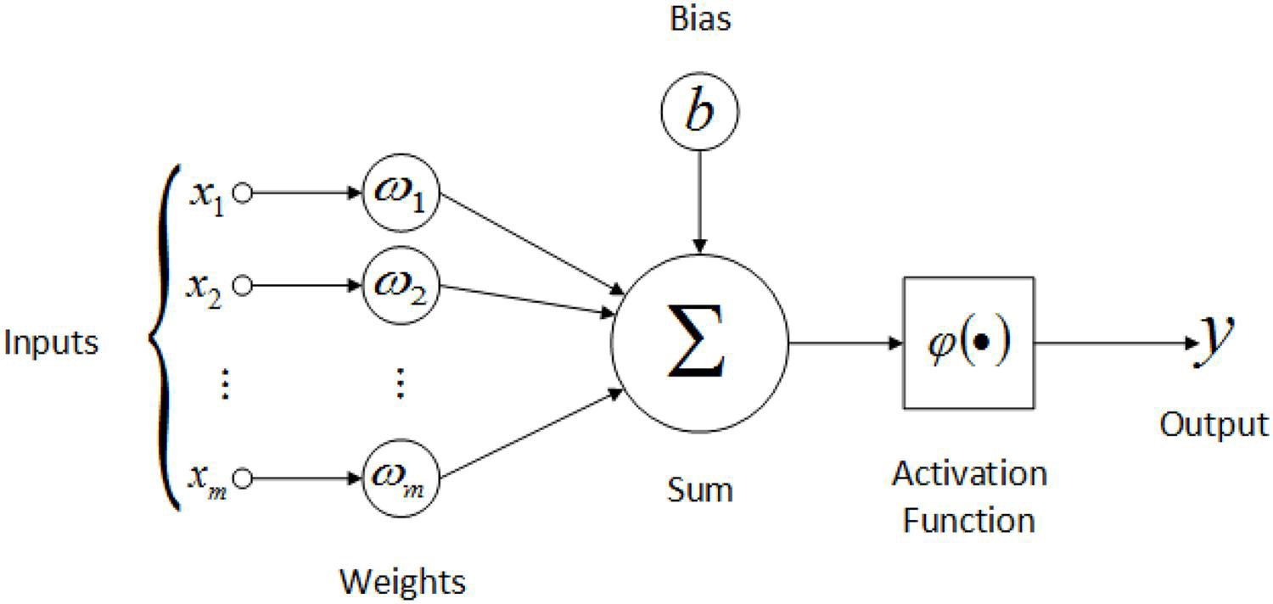
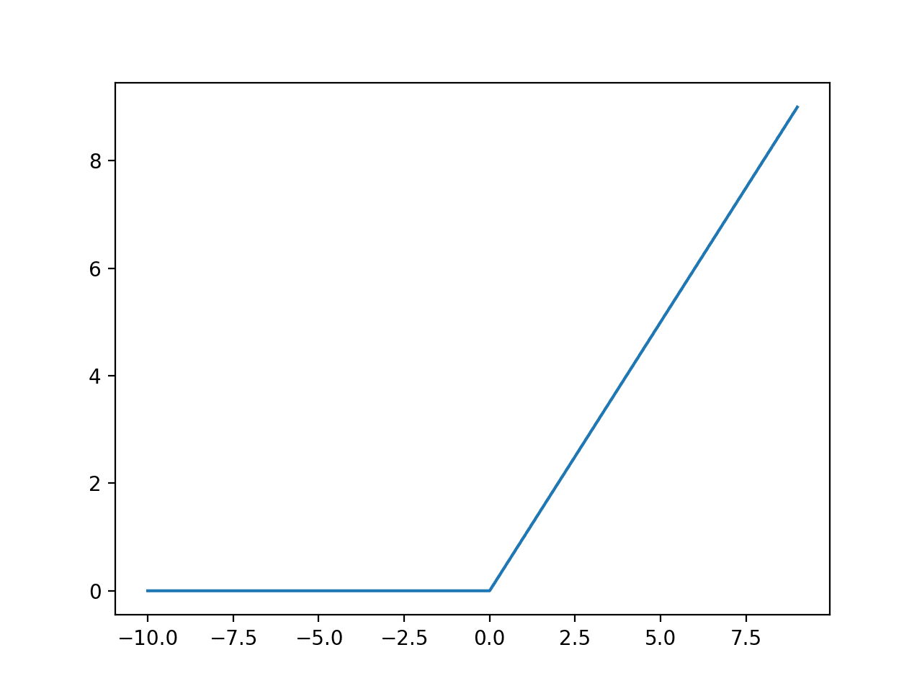
Neuron
$$y=φ(x_{1}∗w_{1}+x_{2}∗w_{2}+…+x_{m} ∗w_{m}+b)$$
Every Neuron has its own weights and biases.
The parameters results from a training algorithm.
Every Neuron outputs only one value.

Slide 4
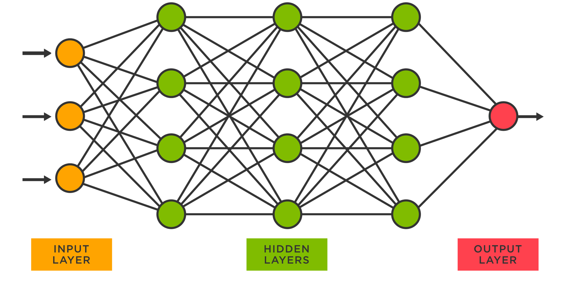
Fully Connected Neural Network
2
3
4
Every Layer can be seen as an entities with a number of inputs equal to the number of neuron of the previous layer and a number of outputs equal to its number of neurons.
1
1
1
1
1
2
2
2
5
2
3
3
3
3
4
4
4

Slide 5



Handwritten numbers detenction
Mnist DataSet
Greyscale Images;
28x28 pixel;
784 values

Slide 6
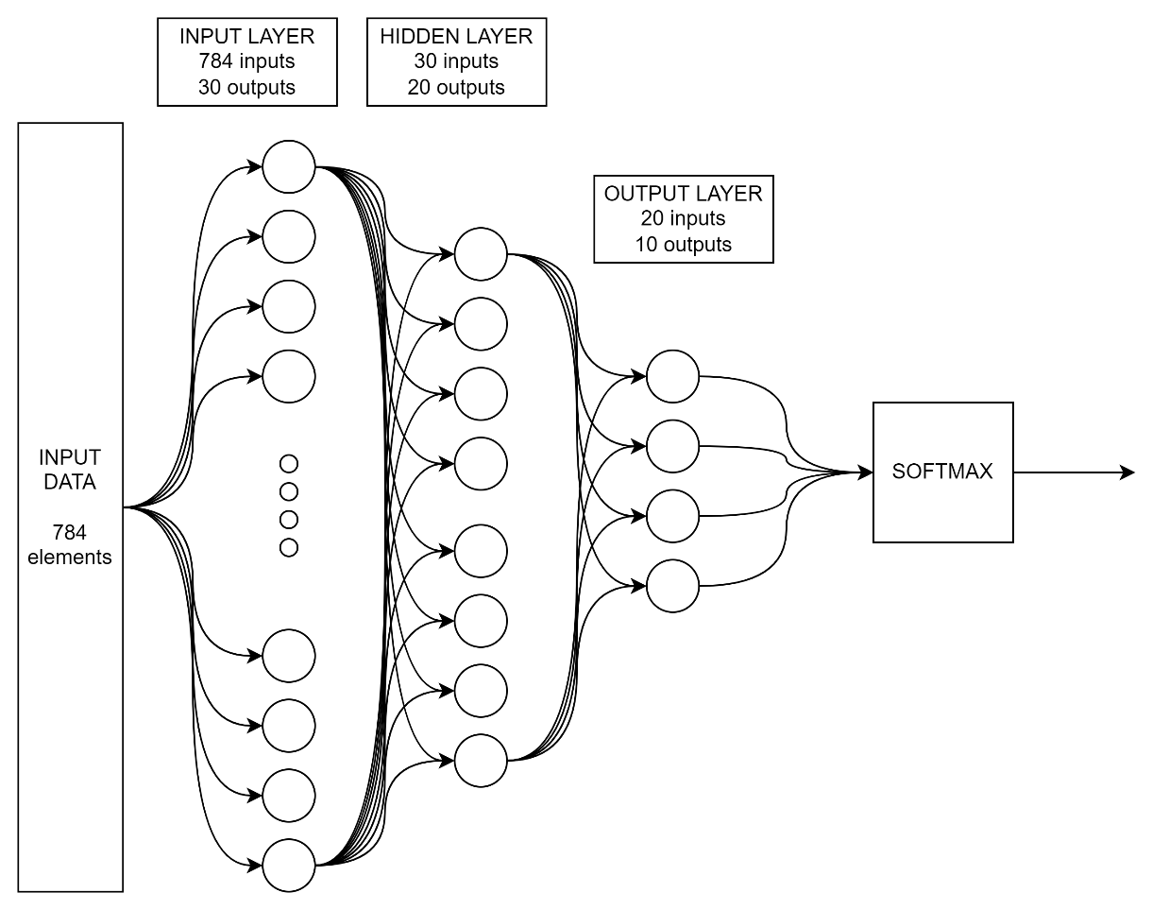
Overall DNN - Fully Connected Neural Netowork
INPUT LAYER: Every neuron of the first layer is connected to every pixel of the image.
OUTPUT LAYER: 10 neurons. Every neurons’ output value reflects the level of confidence the DNN assign that specific number to the input image.
Mnist Package is used to train the DNN; a python script is used to train it; the number of layers of neurons can be modified;

Slide 7
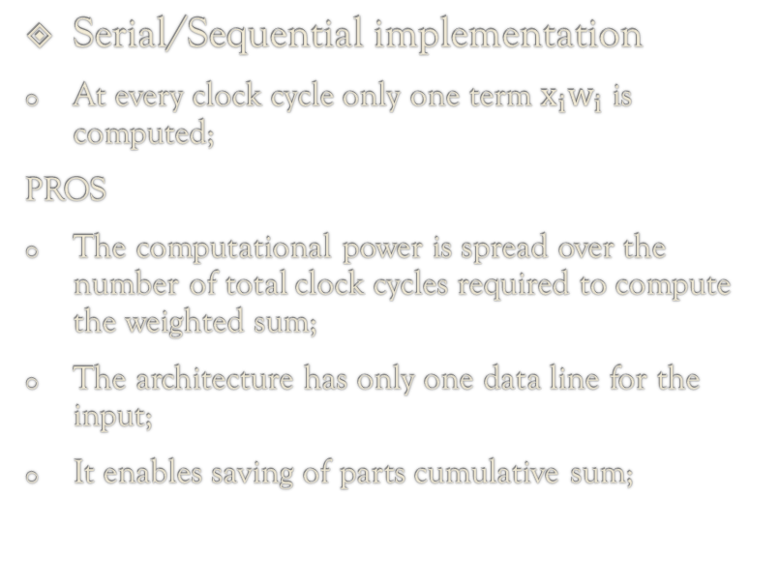
Possible Implementations
Parallel implementation
The whole weighted sum is computed;
CONS
There is the need of a number of data lines equal to the numbers of the input of the layer;
There may be overcrowding of data lines for a given layer;
If the system shuts down in the middle of the computation the weighted sum must be computed from scratch;
Serial/Sequential implementation
At every clock cycle only one term $x_{i}w_{i}$ is computed;
PROS
The computational power is spread over the number of total clock cycles required to compute the weighted sum;
The architecture has only one data line for the input;
It enables saving of parts cumulative sum;
$$y=φ(x_{1}∗w_{1}+x_{2}∗w_{2}+…+x_{m} ∗w_{m}+b)$$
SEQUENTIAL IMPLEMENTATION HAS BEEN IMPLEMENTED
weighted product

Slide 8
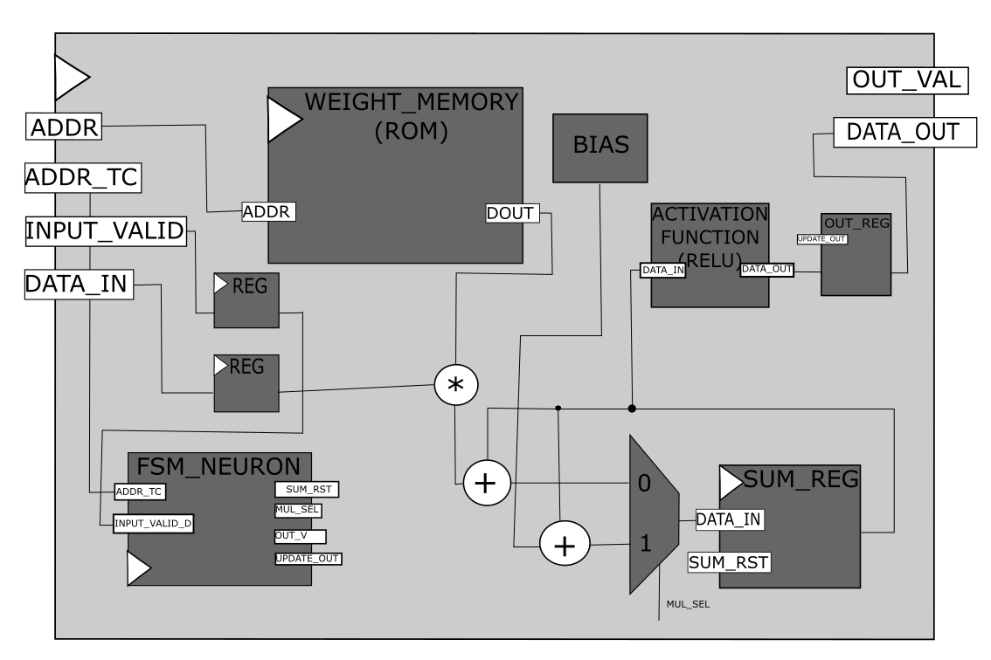

Neuron Implementation
$$num_{bits}\left(ADDR\right)=\log_{2}({num_{inputs})}$$
The weights and bias indentifying the neurons are stored into non-volatile ROMs which are accessed in a sequential fashion;
An accumulator is used for storing the cumulative weighted sum;
Control Logic is implemented by using a Finite State Machine
$$y=φ(x_{1}∗w_{1}+x_{2}∗w_{2}+…+x_{m} ∗w_{m}+b)$$
weighted product

Slide 9
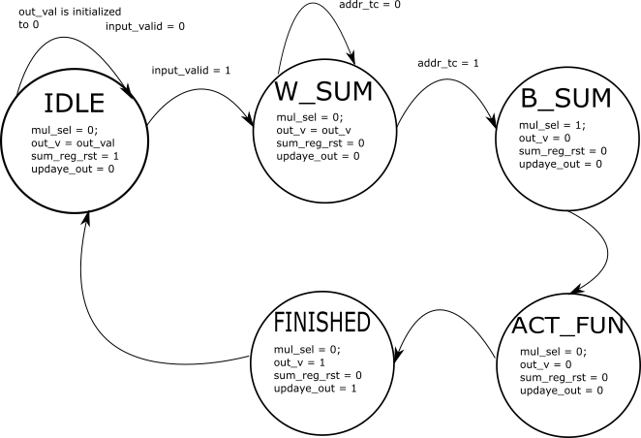
Finite State Machine
FINITE STATE MACHINE
IDLE;
W_SUM;
B_SUM;
ACT_FUN;
FINISHED;
The FSM has been moved outside and modified slightly.

Slide 10
Layer Implementation
THIRD LAYER OUTPUTS
2
3
4
1
1
1
1
$$y_{31}=φ(x_{21}∗w_{11}+x_{22}∗w_{21}+x_{23}∗w_{31}+x_{24}∗w_{41}+b)$$
1
$$y_{32}=φ(x_{21}∗w_{12}+x_{22}∗w_{22}+x_{23}∗w_{32}+x_{24}∗w_{42}+b)$$
2
2
2
5
$$y_{33}=φ(x_{21}∗w_{13}+x_{22}∗w_{23}+x_{23}∗w_{33}+x_{24}∗w_{43}+b)$$
2
3
3
3
$$y_{34}=φ(x_{21}∗w_{14}+x_{22}∗w_{24}+x_{23}∗w_{34}+x_{24}∗w_{44}+b)$$
3
FOURTH LAYER OUTPUTS
4
4
4
$$y_{41}=φ(y_{31}∗w_{11}+y_{32}∗w_{21}+y_{33}∗w_{31}+y_{34}∗w_{41}+b)$$
$$y_{42}=φ(y_{31}∗w_{12}+y_{32}∗w_{22}+y_{33}∗w_{32}+y_{34}∗w_{42}+b)$$
$$y_{43}=φ(y_{31}∗w_{13}+y_{32}∗w_{23}+y_{33}∗w_{33}+y_{34}∗w_{43}+b)$$
$$y_{44}=φ(y_{31}∗w_{14}+y_{32}∗w_{24}+y_{33}∗w_{34}+y_{34}∗w_{44}+b)$$

Slide 11
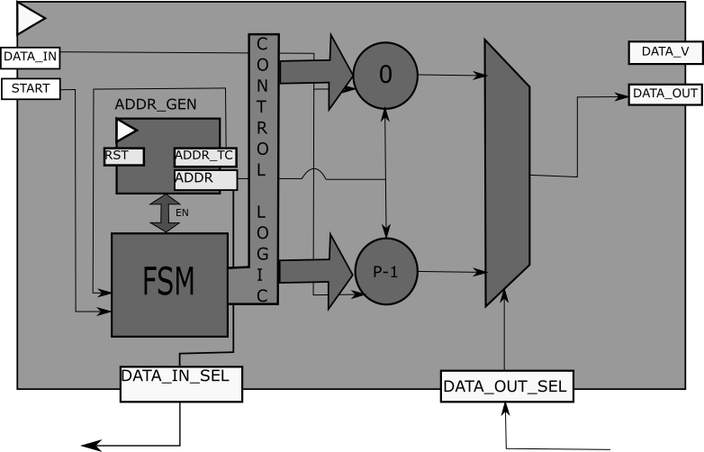
Layer Implementation
$$y=φ(x_{1}∗w_{1}+x_{2}∗w_{2}+…+x_{p} ∗w_{p}+b)$$

Slide 12
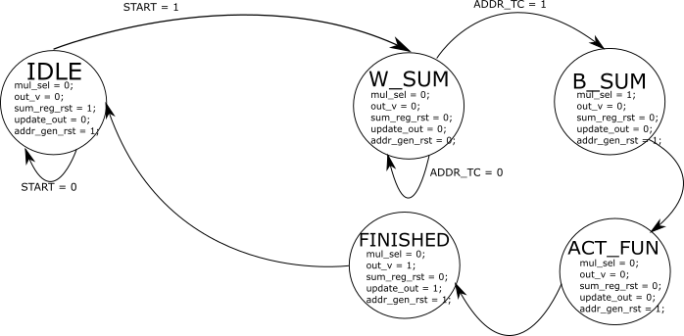
Finite State Machine

Slide 13
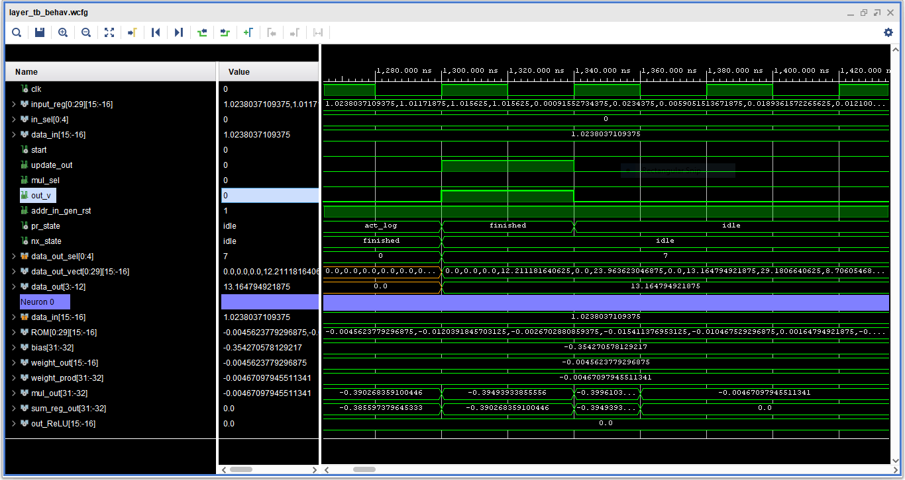
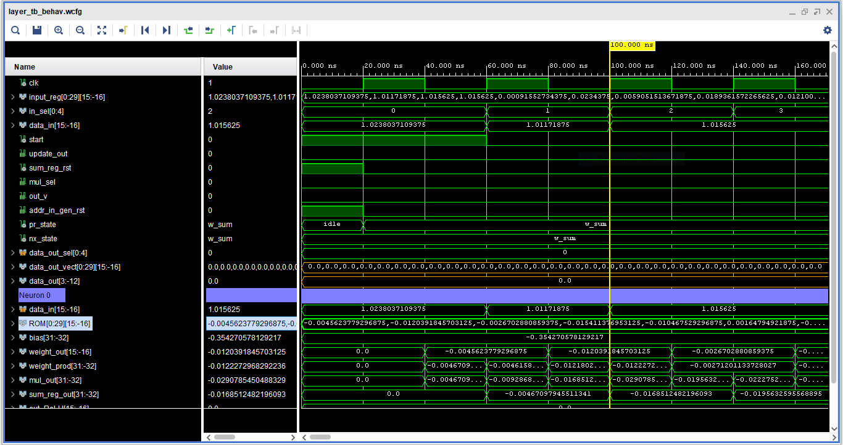
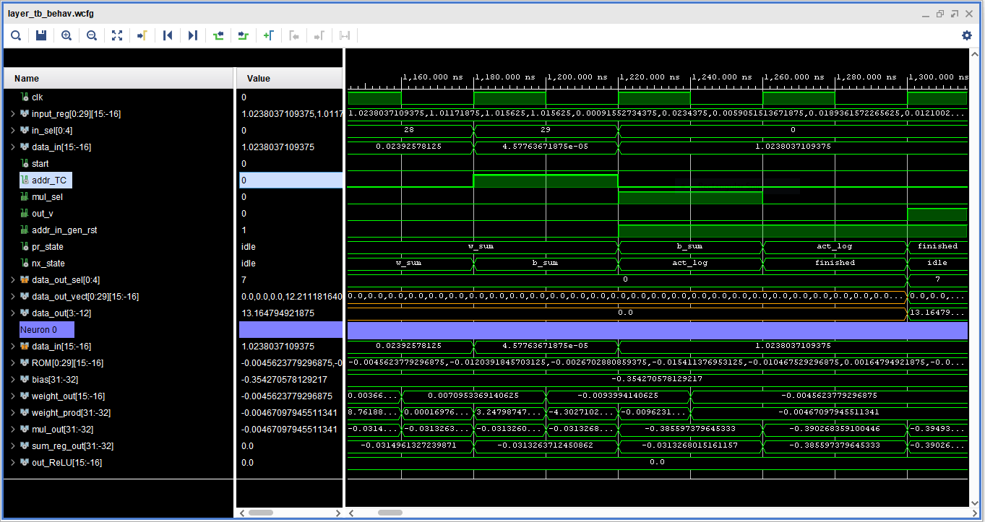
TestBench Layer
Layer: 30 inputs/30 outputs
Input Array
Updating register, Holding the output values of the layers. Accessing the neurons’ output
Adding Bias, Apply activation Logic
Triggering the Layer and Starting computation
addr_TC is set to 1, stop the weighted sum computation
All the neurons’ output registers are updated, data is now ready to be fetched
We access neuron 7

Slide 14
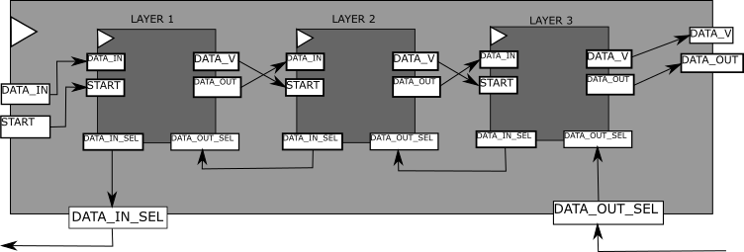
DNN Implementation
Layer output is fetched through this line

Slide 15
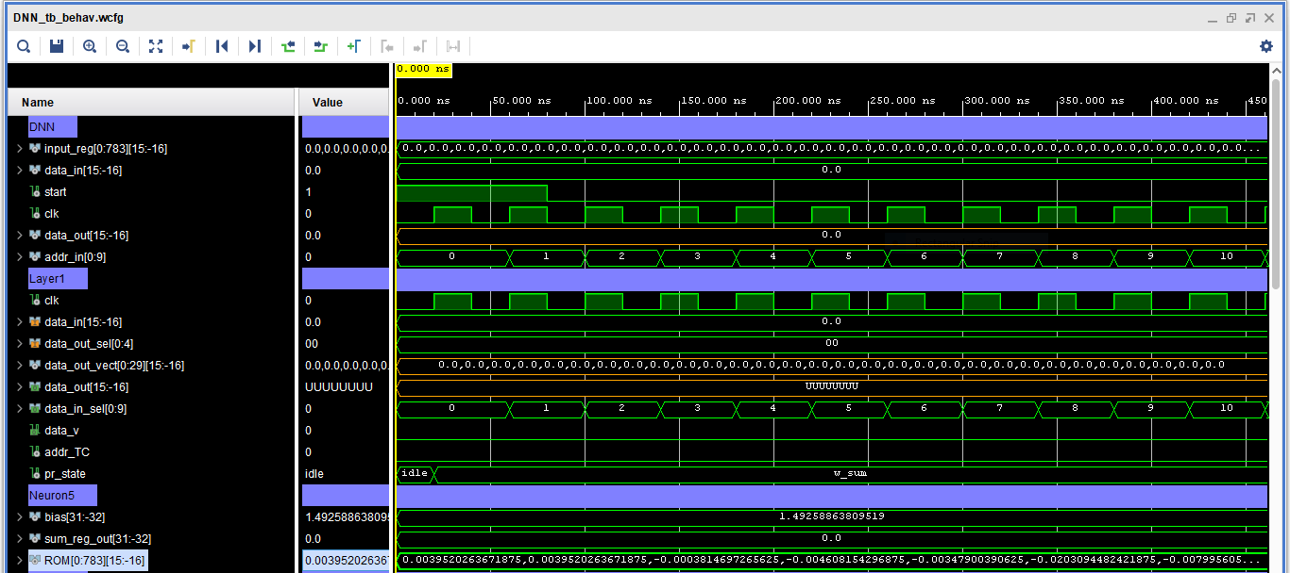
TestBench DNN

Slide 16
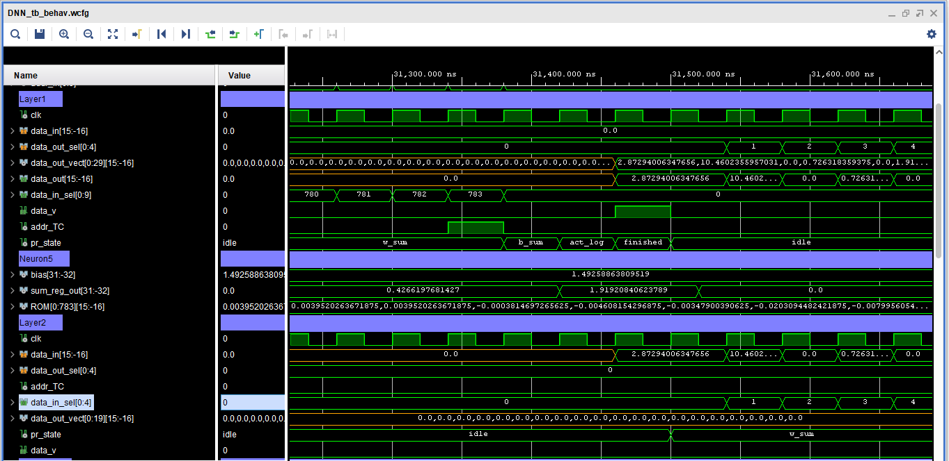
Testbench DNN

Slide 17
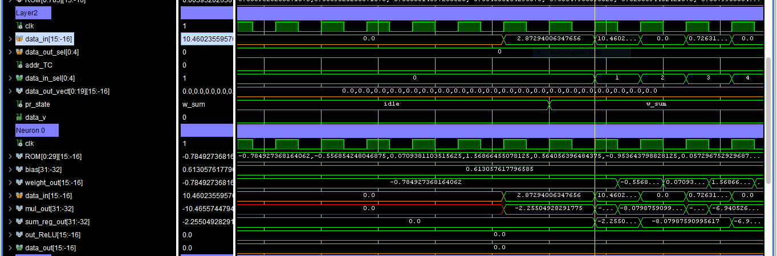
Testbench DNN

Slide 18
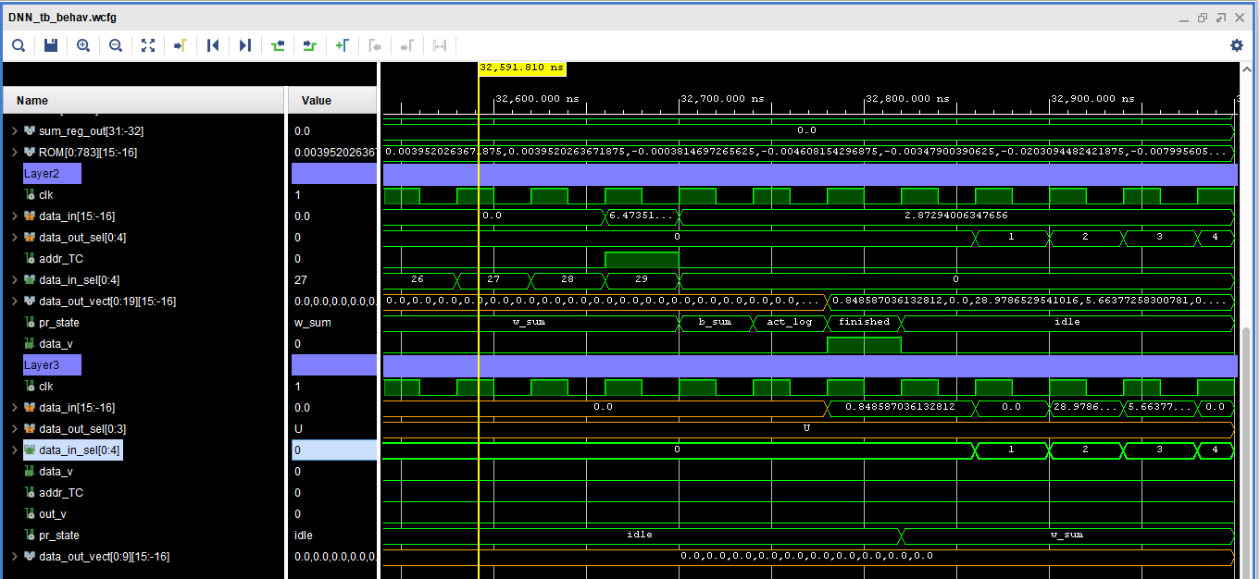
Testbench DNN

Slide 19
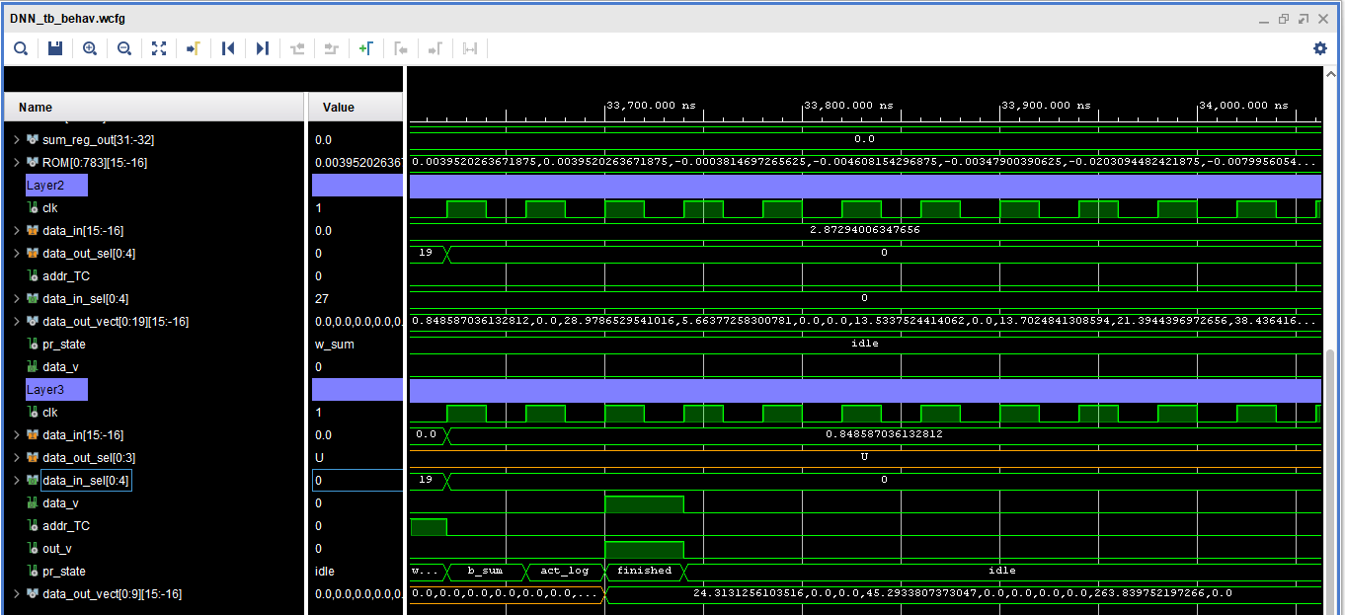
Testbench DNN

Slide 20
Integrating with NORM - Saving The DNN state
NORM Framework Overview
Coupling with NORM

Slide 21
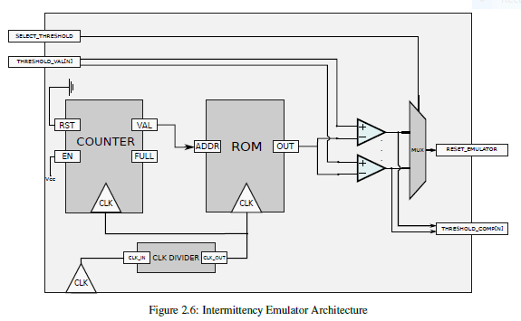
The intermittency emulator
Based on a voltage trace, this module pulls down a reset pin to erase the content of any volatile registers;

Slide 22
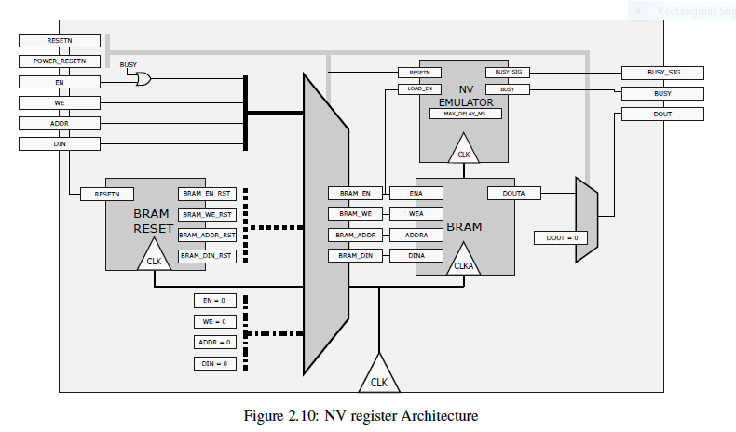
NV Register Architecture
The non-volatile register is implemented by using an block-ram within the FPGA.
Data is saved by storing all the content of Volatile Architecture RAM to the non-volatile register.
Data is retrieved by loading the content of the NV_REG and loadin g it inside the RAM.

Slide 23
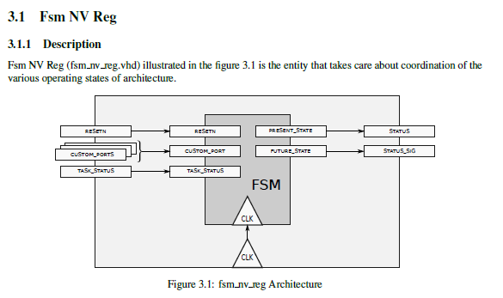
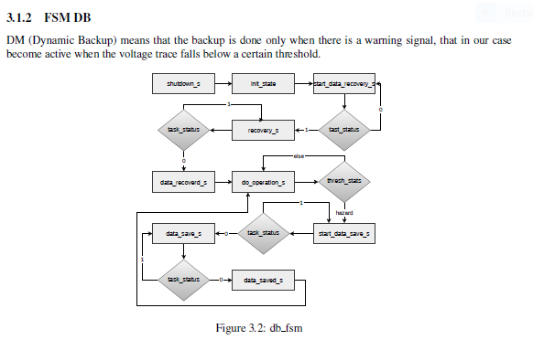
NV_REG FSM
This FSM plans when to carry normal, backup or recovery operations.
The actual implementation resides within the volatile architecture

Slide 24
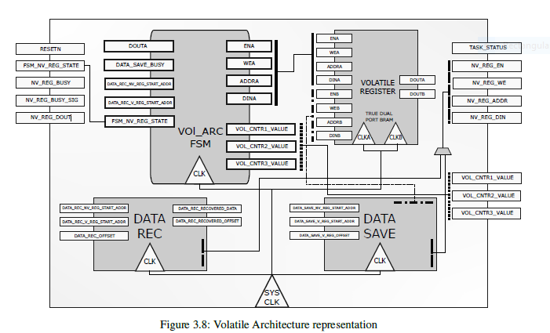
VOLATILE ARCHITECTURE
INTERMITTENCY EMULATOR
TO THE FSM_NV_REG
FROM FSM_NV_REG
FROM THE NV_REG
TO THE NV_REG

Slide 25
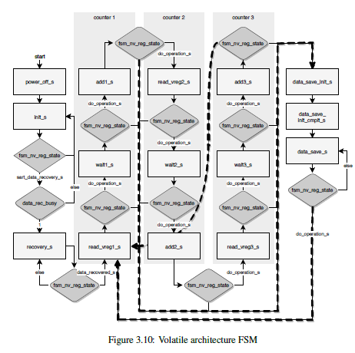
VOLATILE ARCHITECTURE FSM
Surpivises the recovery, backup and normal operation of the volatile architecure. It follows the imperative commands coming from the Non-Volatile FSM.

Slide 26
OVERALL ARCHITECTURE
POWER_RESET
FSM_NV_REG
NV_REG

Slide 27
Coupling the DNN with NORM
POWER_RESET
TASK_STATUS
TASK_STATUS
TASK_STATUS
NV_REG
NV_REG
NV_REG
FSM_NV_REG
TASK_STATUS

Slide 28
Coupling the layer with NORM
The internal FSM of the layer is now also required to interact with the non-volatile FSM machine and carry the operation demanded by FSM_NV_REG.
The FSM will be augumented to implement recovery and backup operation from and and to the NV_REG.
FSM_NV_REG
POWER_RESET
FSM will also need to be extended to support backup, recovery, and do operation
NV_REG

Slide 29
What data to save ?
NEURON
LAYER
State of currently active layer.
State of previous layer

Slide 30
Neuron Added Pins
DATA_OUT_SAVE
DATA_OUT_REC
POWER_RESET
CUM_SUM_SAVE
CUM_SUM_REC
$$y=φ(x_{1}∗w_{1}+x_{2}∗w_{2}+…+x_{m} ∗w_{m}+b)$$

Slide 31
Layer Added Pins
ADDR_GEN_REC
ADDR_GEN_SAVE
FSM_STATE_REC
FSM_STATE_SAVE

Slide 32
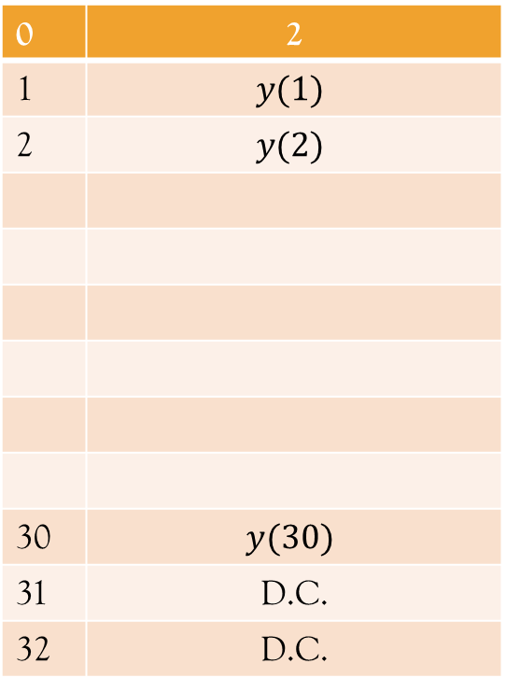
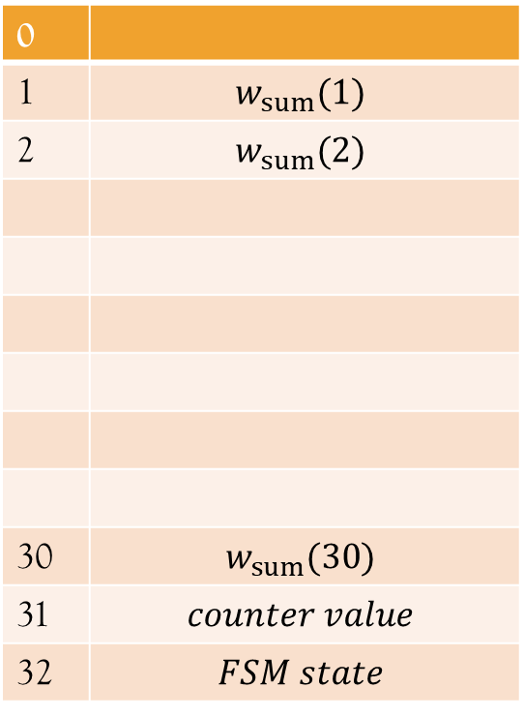
NV_REG CONTENT
NOTHING
OUTPUT
W_SUM
0 | 1
1 | D.C.
2 | D.C.
32 | D.C.
0 | 2
1 | $$y(1)$$
2 | $$y(2)$$
30 | $$y(30)$$
31 | D.C.
32 | D.C.
0
1 | $$w_{sum}(1)$$
2 | $$w_{sum}(2)$$
30 | $$w_{sum}(30)$$
31 | $$counter value$$
32 | $$FSM state$$

Slide 33
DNN Overall Architecture
OUT_V_SET
OUT_V_SET
OUT_V_SET
TASK_STATUS
TASK_STATUS
TASK_STATUS
NV_REG
NV_REG
NV_REG
FSM_NV_REG

